Slide 1
Structures

Slide 2
Outline
Introduction
Syntax
Defining a structure
Accessing members of a structure
typedef
Syntax
Passing structures to a function
Returning a structure from a function

Slide 3
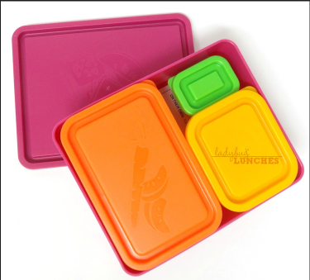
1. Introduction
A structure is a collection of related storage elements under a single name.
The elements in a structure can be of different types.
All elements in a structure typically related semantically.
Structure
Storage elements
Image src: http://www.ladybug-lunches.com/2013/07/bento-buddies-review.html

Slide 4
1.1. Defining a Structure Type (Syntax)
struct struct_name {
type1 member1;
type2 member2a, member2b;
…
typeN memberN;
};
Define what kinds of data to hold.
A structure type is a defined using the keyword struct.
We need to define a structure type before we can declare variables of that type to store values.

Slide 5
1.1. Defining a Structure Type
Another example:
This defines a new data type called struct student, which consists of three related members: id, name, and gpa.
/* define a NEW type for storing data LATER */
struct student {
char id[11];
char name[40];
double gpa;
};
Note the semicolon (;) at the end.

Slide 6
1.1. Defining a Structure Type
Important:
This defines only a new data type called struct student.
No variable storage has YET been allocated.
This is just the blueprint (design) of the new type.
/* define a NEW type for storing data LATER */
struct student {
char id[11];
char name[40];
double gpa;
};

Slide 7
1.1. Defining a Structure Type
Structure variables can then be declared just like variables of simple data types.
E.g.,
struct student peter;
This is the type name.
This is the variable name.
peter
id
1
1
5
5
0
1
2
3
0
4
5
\0
name
P
e
t
e
r
P
a
n
\0
?
…
?
gpa
3.63

Slide 8
1.1. Altogether: Global Structure Type
A struct type is usually defined outside any functions.
#include <stdio.h>
/* define a NEW type for storing data LATER */
struct student {
char id[11];
char name[40];
double gpa;
};
int main() {
/* a variable declaration using the NEW type*/
struct student peter;
int no_of_students;
...
}
Global
scope
Local
variable

Slide 9
1.2. Another Example
1
2
3
4
5
6
7
8
9
10
11
12
13
14
15
16
17
struct date {
int day, month, year;
};
int main(void) {
struct date d1, d2;
// Assign 10 to the
// member "day" of d1
d1.day = 10;
// Assign 2014 to the
// member "year" of d2
d2.year = 2014;
return 0;
}
Defining a new structure type named date.
In this definition, we specify that each "value" of this type contains three members (day, month, and year) which are of type int.

Slide 10
1.2. Another Example
1
2
3
4
5
6
7
8
9
10
11
12
13
14
15
16
17
struct date {
int day, month, year;
};
int main(void) {
struct date d1, d2;
// Assign 10 to the
// member "day" of d1
d1.day = 10;
// Assign 2014 to the
// member "year" of d2
d2.year = 2014;
return 0;
}
"struct date" is the name of the newly defined type.
At line 6, we declare two variables, d1 and d2, of type "struct date".

Slide 11
1.2. Another Example
1
2
3
4
5
6
7
8
9
10
11
12
13
14
15
16
17
struct date {
int day, month, year;
};
int main(void) {
struct date d1, d2;
// Assign 10 to the
// member "day" of d1
d1.day = 10;
// Assign 2014 to the
// member "year" of d2
d2.year = 2014;
return 0;
}
d1
day
?
month
?
year
?
d2
day
?
month
?
year
?
Each variable of type "struct date" has its own members.
Initially the members are uninitialized.

Slide 12
1.2. Another Example
1
2
3
4
5
6
7
8
9
10
11
12
13
14
15
16
17
struct date {
int day, month, year;
};
int main(void) {
struct date d1, d2;
// Assign 10 to the
// member "day" of d1
d1.day = 10;
// Assign 2014 to the
// member "year" of d2
d2.year = 2014;
return 0;
}
d1
day
10
month
?
year
?
d2
day
?
month
?
year
?
The dot operator (.) is called a member selection operator.
d1.day means "select the member day of d1".

Slide 13
1.2. Another Example
1
2
3
4
5
6
7
8
9
10
11
12
13
14
15
16
17
struct date {
int day, month, year;
};
int main(void) {
struct date d1, d2;
// Assign 10 to the
// member "day" of d1
d1.day = 10;
// Assign 2014 to the
// member "year" of d2
d2.year = 2014;
return 0;
}
d1
day
10
month
?
year
?
d2
day
?
month
?
year
2014
A member of type int is just like a regular variable of type int. Any syntax that is valid for a variable of type int is also valid for a member of type int.

Slide 14
1.3. More Structure Examples
Quadratic form Ax²+Bx+C
struct quad_form {
double A, B, C,;
};
Polynomial Ax^{n}+Bx^{n-1}+…+E
struct polynomial {
int degree;
double coeff[10];
};
2D Coordinates
struct coord2D {
double x;
double y;
};
Employee record
struct employee {
char name[50];
double salary[12];
double MPF_contrib;
};

Slide 15
1.4. Accessing struct Members
The Member Operator:
Members of a struct variable can be accessed using the member operator, i.e. the DOT .
For example, variable.member = 999;
where variable is a struct variable and member is a defined component of the struct.

Slide 16
1.4. Accessing struct Members
The previous example:
…
int main() {
struct student peter;
peter.gpa = 3.28;
…
}
peter
id
1 | 1 | 5 | 5 | 0 | 1 | 2 | 3 | 4 | 5 | \0
name
P | e | t | e | r |  | P | a | n | \0 | …
gpa
3.28

Slide 17
1.4. Accessing struct Members (Another Example)
1
2
3
4
5
6
7
8
9
10
11
12
13
14
15
16
17
1819
struct date { int day, month, year; };
int main(void) {
struct date today, dob; // Declare 2 variables
today.day = 19;
today.month = 11;
today.year = 2014;
printf("Date of birth (dd mm yyyy)? ");
scanf("%d%d%d", &dob.day, &dob.month, &dob.year);
if (today.month > dob.month ||
(today.month == dob.month && today.day >= dob.day))
printf( "Age = %d\n", today.year - dob.year );
else
printf( "Age = %d\n", today.year - dob.year - 1 );
return 0;
}

Slide 18
1.5. Initializing Structures
struct variables can be initialized as follows:
If there are not enough initializers, values of the remaining members are assigned zero by default.
struct date today = {25, 12};
/* today.year is assigned 0 implicitly */
struct date {
int day, month, year;
};
int main() {
struct date today = {25, 12, 1997};
…
}

Slide 19
1.5. Initializing Structures
The initializers should be constant values or constant expressions.
No variables should be involved in the initializer expressions.
struct date {
int day, month, year;
};
int main() {
int i = 1997;
struct date today = { 25, 12, i }; /* Wrong */
…
}

Slide 20
1.5. Initializing Structures (More Examples)
struct employee {
char name[50];
double salary[12];
double MPF_contrib;
};
struct employee peter = {
"Peter Pan",
{ 9500, 9500, 10000, 11000, 12000, 12050,
12100, 13000, 13000, 13000, 14000, 14000},
0.05
};

Slide 21
1.6. Assignment of Structures
struct date d1, d2 = { 1, 1, 2014 };
d1 = d2; // Copy d2 to d1 (all data byte by byte)
A struct value can be copied using the assignment operator.

Slide 22
1.6. Assignment of Structures
The assignment operator = can be applied to structure variables.
Individual member of the source structure is copied to the corresponding member of the target structure.
This applies even to array members in the structure, i.e., it also makes a copy of the array member inside the structure.
Structure assignment (COPYING and PASSING) consumes computing TIME, but it's CONVENIENT!

Slide 23
1.6. Assignment of Structures
1
2
3
4
5
6
7
8
9
10
11
12
13
14
15
16
17
18
19
20
#include <stdio.h>
#define NAMEMAX 30
struct person_t {
char surname[NAMEMAX+1], forename[NAMEMAX+1];
int age; /* Two arrays in the structure */
};
int main() {
struct person_t computer1;
struct person_t computer2 = { "Machine", "Computing", 50 };
computer1 = computer2; /* Structure assignment */
printf("computer 1: %s %s\n", computer1.forename,
computer1.surname);
printf("computer 2: %s %s\n", computer2.forename,
computer2.surname);
return 0;
}
This is a trick to have changeable array size!
computer 1: Computing Machine
computer 2: Computing Machine

Slide 24
1.7. Defining an alias to an existing data type
We can introduce an alias (別名) to an existing data type using typedef.
Syntax
typedef existing_type_name alias;
After the declaration, both alias and existing_type_name refer to the same data type.

Slide 25
1.7. Defining an alias to an existing data type
struct date {
int day, month, year;
};
int main(void) {
struct date d1, d2;
...
}
struct date {
int day, month, year;
};
typedef struct date Date;
// From this point onward,
// "Date" becomes an alias of
// "struct date"
int main(void) {
Date d1, d2;
struct date d3;
// The types of d1, d2, and
// d3 are the same
...
}
Do not add the keyword struct in the front.

Slide 26
1.7. Combining typedef with structure definition
struct date {
int day, month, year;
};
typedef struct date Date;
Defining a struct type named "date" and defining an alias to the struct type in two separate declarations.
equivalent to
Defining a struct type named "date" and defining an alias to the struct type in one declaration.
typedef struct date {
int day, month, year;
} Date;
almost equivalent to
typedef struct {
int day, month, year;
} Date;
Defining a struct type with no name and defining an alias to the struct type in one declaration.
With the first two approaches, the type can be referred to in the program as "struct date" and "Date". With the 3rd approach, the type can only be referred to in the program as "Date".

Slide 27
1.7. More typedef examples
struct student {
char id[11];
char name[40];
double gpa;
}; /* A structure declaration */
typedef struct student STUDENT_t; /* An alias */
...
STUDENT_t peter; /* Declare variable peter */
Define STUDENT_t as an alias to struct student. This allows shorter type names.
STUDENT_t is also called a Type-Defined Structure.

Slide 28
2. Structures and Functions
2.1. Structures as Function Parameters
void func( struct rational rat )
2.2. Structures as Function Return Values
struct rational func( )
2.3. Structures as BOTH Function Parameters and Function Return Values
struct rational func( struct rational rat )

Slide 29
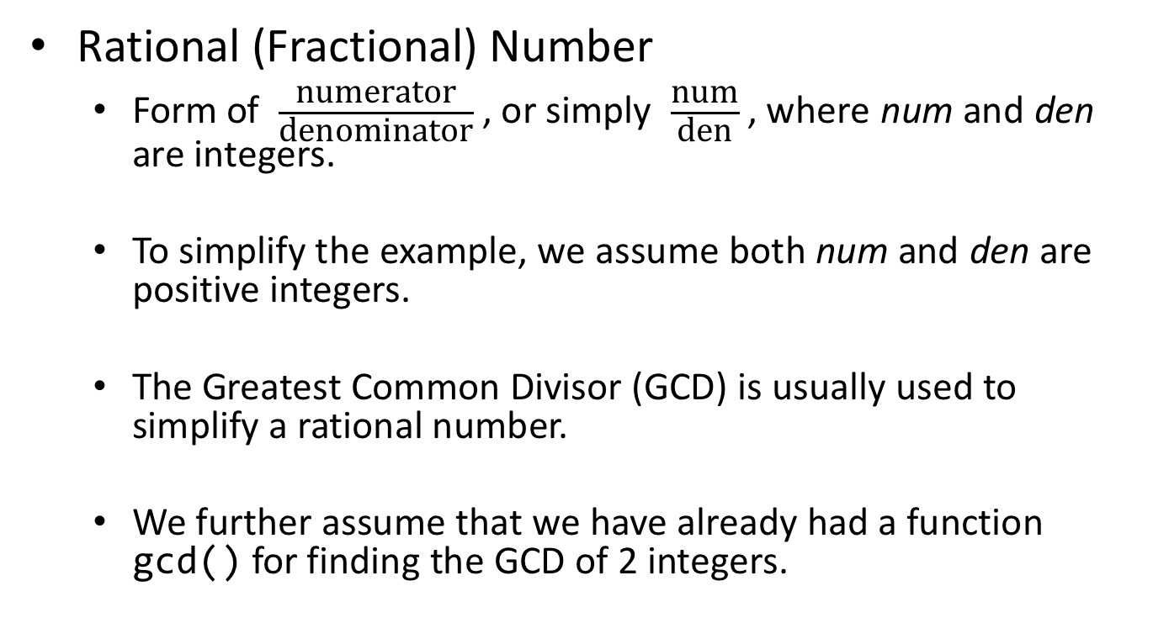
2.1. Structures as Function Parameters
Rational (Fractional) Number
Form of $\frac{\text{numerator}}{\text{denominator}}$ , or simply $\frac{\text{num}}{\text{den}}$ , where num and den are integers.
To simplify the example, we assume both num and den are positive integers.
The Greatest Common Divisor (GCD) is usually used to simplify a rational number.
We further assume that we have already had a function gcd() for finding the GCD of 2 integers.

Slide 30
2.1. Structures as Function Parameters
1
2
3
4
5
6
7
8
9
10
11
12
13
14
15
16
17
18
19
20
21
22
23
24
#include <stdio.h>
struct rational { /* Define the structure "rational" */
int num, den;
};
void r_Print( struct rational rat ) { // A function for
printf("%d / %d", rat.num, rat.den); // printing rational
}
double r_Real( struct rational rat ) { // A function for
return (double)rat.num / rat.den; // obtaining real number
}
int main() {
struct rational three_over_four = {3, 4};
double real_num;
r_Print( three_over_four ); // Function call
real_num = r_Real( three_over_four ); // Function call
printf(" = %f\n", real_num);
return 0;
}
3 / 4
= 0.750000

Slide 31
2.2. Structures as Function Return Values
1
2
3
4
5
6
7
8
9
10
11
12
13
14
15
16
17
18
19
20
21
22
23
…… /* struct definition and r_Print from Program 2.1 */
struct rational r_Create( int n, int d ) {
struct rational rat;
int g;
g = gcd(n, d); /* Assume existence of gcd() */
rat.num = n / g;
rat.den = d / g;
return rat;
}
int main() {
struct rational rat_68 = {6, 8}; /* struct initialization */
r_Print( rat_68 );
printf(" --> ");
struct rational rat_34;
rat_34 = r_Create( 6, 8 ); /* struct assignment */
r_Print( rat_34 );
return 0;
}
Properly assign the members before returning a struct value
6 / 8
-->
3 / 4

Slide 32
2.3. Structures as BOTH Parameters and Return Values
1
2
3
4
5
6
7
8
9
10
11
12
13
14
15
16
17
18
19
20
21
22
23
… /* struct definition and other functions same as before */
typedef struct rational Rational; /* alias */
Rational r_Add( Rational rat1, Rational rat2 ) {
int num, den;
num = rat1.num * rat2.den + rat2.num * rat1.den;
den = rat1.den * rat2.den;
return r_Create( num, den );
}
int main() {
Rational six_over_eight, one_over_two;
six_over_eight = r_Create( 6, 8 );
r_Print( six_over_eight );
printf(" + ");
one_over_two = r_Create( 1, 2 );
r_Print( one_over_two );
printf(" = ");
r_Print( r_Add( six_over_eight, one_over_two ) );
return 0;
}
3 / 4
+
1 / 2
=
5 / 4

Slide 33
3. [Optional] More Structures
3.1. Array in Structures
3.2. Array of Structures
struct student student_list[100];
3.3. Nested Structures
struct student {
char name[30];
struct date dob;
}

Slide 34
3.1. Array Members of Structures
1
2
3
4
5
6
7
8
9
10
11
12
13
14
15
16
17
18
19
20
21
22
#include <stdio.h>
#define NAMEMAX 100
struct person {
char surname[NAMEMAX+1];
char forename[NAMEMAX+1];
int age;
};
int main() {
struct person computer = { "Machine", "Computing", 50 };
struct person user;
printf("Your surname? ");
scanf("%s",user.surname);
printf("Your forename? ");
scanf("%s",user.forename);
printf("Dear %c. %s\n", user.forename[0], user.surname);
printf("I am %s.\n", computer.forename);
return 0;
}
/* Define the type struct person */
Your surname? WAY↵
Your forename? Peter↵
Dear P. WAY
I am Computing.

Slide 35
3.1. Array Members of Structures
Entities | Meaning/ Description | Type/ Value
computer | The whole structure | struct person
computer.surname | The whole string member surname | char [] "Machine"
computer.surname[0] | The 1st character of string computer.surname | char 'M'
computer.forename[4] | The 5th character of computer.forename | char 'u'
computer.age | The member age | int 50
struct person {
char surname[NAMEMAX+1];
char forename[NAMEMAX+1];
int age;
};

Slide 36
3.2. Array of Structures
Structures may occur as an array.
Example:
struct student {
char id[11];
char name[40];
int mark;
};
int main(void) {
struct student student_list[100];
student_list[5].mark = 98;
if ( student_list[6].id[1] == '0' )
printf("Admitted before 2010/11");
}

Slide 37
3.2. Array of Structures
array variable student_list
student_list[0]
student_list[1]
…
student_list[99]
id[]
id[]
id[]
…
name[]
name[]
name[]
mark
mark
mark
Entities | Meaning/ Description
student_list | An array of struct student
student_list[2] | The 3rd element of the array, a variable of type struct student
student_list[i].name | The name of the (i+1)^{th} student in the array, a string
student_list[i].name[j] | The (j+1)^{th} character of the name of the (i+1)^{th} student in the array, a single char

Slide 38
3.3. Nested Structures
1
2
3
4
5
6
7
8
9
10
11
12
13
14
15
16
17
18
19
20
21
22
23
24
25
26
#include <stdio.h>
#include <string.h>
struct date {
int day, month, year;
};
struct book {
char author[30], title[50], publisher[30];
int edition;
struct date date_of_pub;
};
int main(void) {
struct book booklist[100];
strcpy( booklist[10].author, "Al Kelley, Ira Pohl" );
strcpy( booklist[10].title, "C By Dissection" );
strcpy( booklist[10].publisher, "Addison-Wesley" );
booklist[10].edition = 4;
booklist[10].date_of_pub.day = 1;
booklist[10].date_of_pub.month = 10;
booklist[10].date_of_pub.year = 2000;
...
return 0;
}
Multiple levels of dots!

Slide 39
Summary
A structure is a means for a programmer to group related variables into one "container".
Each member of a structure is like a regular variable. Their main difference is in the syntax.
Syntax which you should remember
Defining a structure (with and without typedef)
Using structure and accessing members of a structure by the member operator “.”.
Structures can be members of other structures. (Nested structures)
Structure assignment can potentially be expensive.
Structure values can be passed as function parameters and also returned from functions.

Slide 40
Reading Assignment
C: How to Program, 8th ed, Deitel and Deitel
Chapter 10 C Structures
Sections 10.1 – 10.4: Structure Basics
Section 10.5: Using Structures with Functions
Section 10.6: typedef
Section 10.7: A Practical Example

